Slide 1

How to write test cases?

Slide 2
How to write test case?
Read requirement carefully, define which functions need to be tested
Note down questions about requirement (if any)
Break requirement in to cases
Outline possible cases that might be happen
Write test case

Slide 3
Needed information in a test case
Test case id:
Unit to test: What to be verified?
Test data: Variables and their values
Test description/ Test name: Steps to be executed: Expected result: Pass/Fail: Comments:

Slide 4
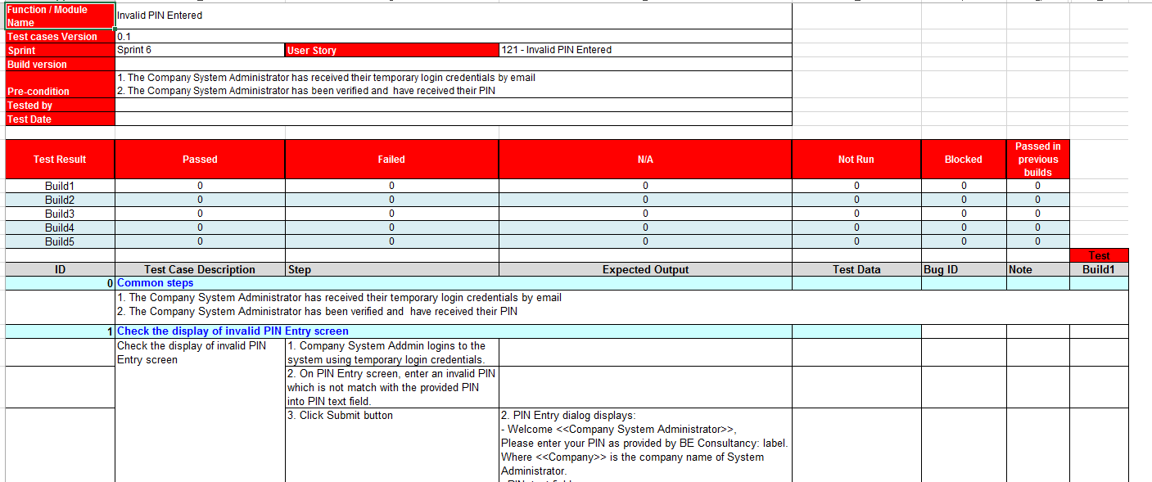
PG’s Test Template

Slide 5
Notice
Don’t need to specify the expected result for each test step if the result is obvious.
If test case has too many test steps, think about breaking up the test case into a set of smaller ones
Remember Preconditions
Expected Result should clearly mention the expected result of the application/system under test.
Legible & Easily Understandable by others
Do not Assume
Peer review is helpful

Slide 6
Q&A

